Slide 1
Call Graphs (recall) and Subroutine Construction

Slide 2
Call Graph
a control flow graph depicting the relationships between subroutines
Call Graph for the "Hello World" program
main
print
print
println
class HelloWorld
{
public static void main(String args[])
{
System.out.print("Hello ");
System.out.print("World"); System.out.println("");
}
}
call:
return:

Slide 3
Call Graph II
main
public static void A(void) {
int x = 5;
C();
}
public static void B(void) {
C();
D();
}
public static void C(void) {
;
}
public static void D(void) {
;
}
public static void main(String args[])
{
A();
B();
}
}
A
B
D
C
leaf nodes

Slide 4
Call Graph with a Loop (Recursion)
main
public static void A(void) {
int x = 5;
C();
}
public static void B(void) {
C();
D();
}
public static void C(void) {
A();
}
public static void D(void) {
;
}
public static void main(String args[])
{
A();
B();
}
}
A
B
D
C
leaf node

Slide 5
Dynamic Call Graph (Runtime)
main
public static void A(void) {
static int x = 5;
C();
}
public static void B(void) {
C();
D();
}
public static void C(void) {
A();
}
public static void D(void) {
;
}
public static void main(String args[])
{
A();
B();
}
}
x = 5;
A
C
x = 5;
A
C

Slide 6
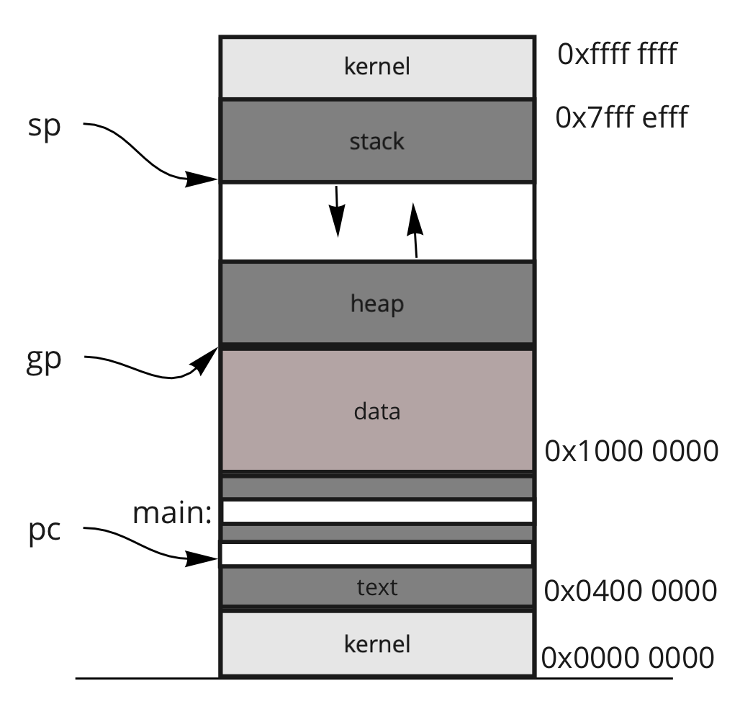
Frames
current address saved in a register
well-known addresses
args
locals
main
temps
args
locals
x = 5;
A
temps
args
locals
C
temps
fp:
args
locals
x = 5;
A
temps
sp:
args
locals
C
temps

Slide 7
Subroutine Transition: Calling a Subroutine
The Client (C) needs to:
Place actual args into the Frame
Precall (preparation for the call)
Transition
The Producer (P) needs to:
Setup
Do it's Thing
$ra = PC + 4; PC = P
precall
set up
C
P
C: nop ... nop # precall jal P nop nop # postcall
...
jr $ra # return
P: nop nop # set up
...
nop # cleanup nop # return value
jr $ra

Slide 8
Subroutine Transition: Return from a Subroutine
The Client (C) needs to:
Postcall
Continue doing it's thing
The Producer (P) needs to:
Clean up
Position the return value
Transition back
C
P
postcall
PC = $ra
clean up
C: nop ... nop # precall jal P nop nop # postcall
...
jr $ra # return
P: nop nop # set up
...
nop # clean up nop # return value
jr $ra

Slide 9
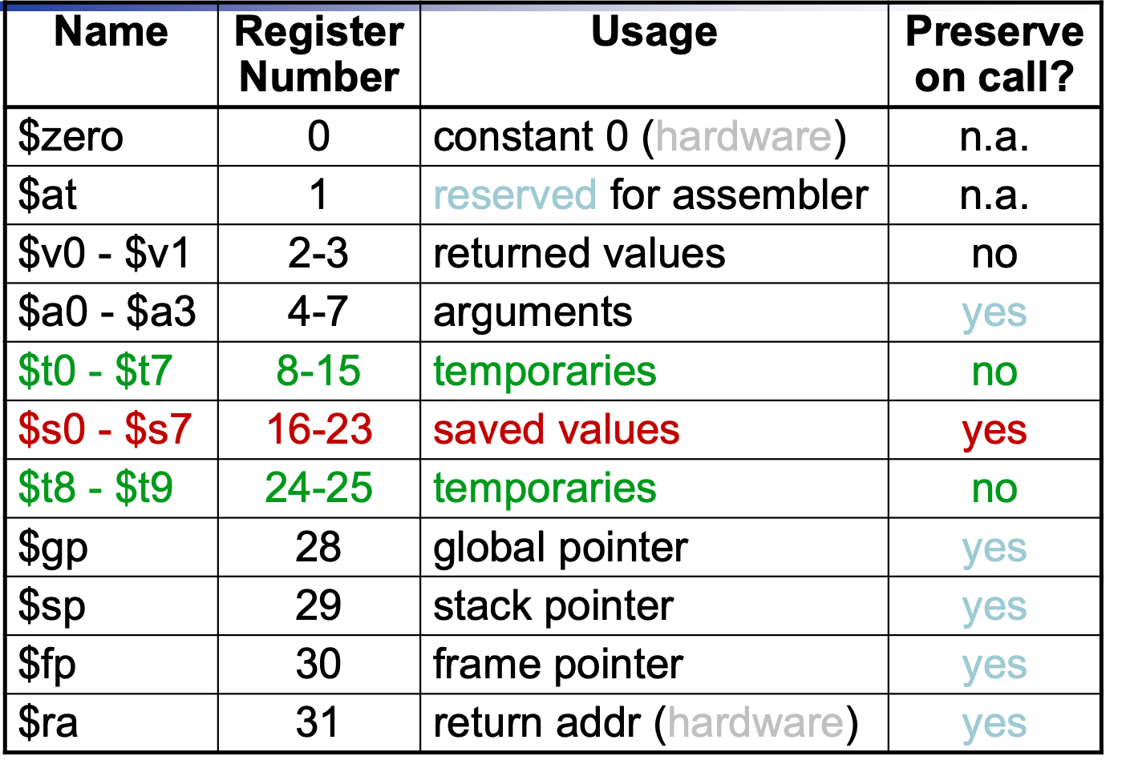
Shared Resource: Registers
You need to perform setup and cleanup routines for any shared resource!
Precall:
Save what you need,
Clear what you want private,
Leave alone what is passed along!
Brute Force Approach:
ignore: $zero, $at, $k1, $k2
save all other registers
especially:
$gp: might as well!
$sp: this is the end of my frame
$fp: this is the start of my frame
$ra: this is my "return to" location
C
P
save

Slide 10
Shared Resource: Registers
You need to perform setup and cleanup routines for any shared resource!
Semi-Optimal
ignore: $zero, $at, $k1, $k2
save only registers in local use
but always save:
$gp: might as well!
$sp: this is the end of my frame
$fp: this is the start of my frame
$ra: this is my "return to" location
used by both C & P
C
P
save

Slide 11
Shared Resource: Registers
You need to perform setup and cleanup routines for any shared resource!
MIPS Conventions
Client (C): saves:
all T registers
$gp: might as well!
$sp: this is the end of my frame
$fp: this is the start of my frame
$ra: this is my "return to" location
Provider (P): saves:
all S registers
C
P
save
save

Slide 12
MIPS: Subroutine Process
The Client (C) needs to:
Postcall ← Restore saved registers
Do it's Thing
The Producer (P) needs to:
Cleanup ← Restore S registers
Position the return value
Transition back
$ra = PC + 4; PC = P
precall
set up
C
P
postcall
PC = $ra
cleanup
C: nop ... nop # precall jal C nop nop # postcall
...
jr $ra # return
P: nop nop # set up
...
nop # clean up op # return value
jr $ra

Slide 13
Stack Operations
Push(a) ⇔ sp = sp + 1
sp[0] = a
x = Pop() ⇔
x = sp[0] sp = sp - 1
Stack is an abstract data structure
Operations:
Push: Push(A), Push(B), Push(C)
Pop: X = Pop();
Push: Push(Z);
sp:
C
C
sp:
Z
sp:
B
B
sp:
B
B
sp:
A
A
A
A
A
sp:
Push(A);
Push(B);
Push(C);
X = Pop()
Push(Z)

Slide 14
But the MIPS Way
Push(a) ⇔
sp = sp - 1
sp[0] = a
x = Pop() ⇔
x = sp[0] sp = sp + 1
Stack is an abstract data structure
Operations:
Push: Push(A), Push(B), Push(C)
Pop: X = Pop();
Push(a) ⇔
subi $sp, $sp, 4
sw $a0, 0($sp)
x = Pop() ⇔
lw $v0, 0($sp) addi $sp, $sp, 4
sp:
A
A
A
A
sp:
B
B
sp:
B
sp:
C
C
Push(A);
Push(B);
Push(C);
X = Pop()

Slide 15
Multiple Pushes / Pops
Push(a) ⇔
sp = sp - 1
sp[0] = a
x = Pop() ⇔
x = sp[0] sp = sp + 1
sp:
Push(a) ⇔
subi $sp, $sp, 4
sw $a0, 0($sp)
x = Pop() ⇔
lw $v0, 0($sp) addi $sp, $sp, 4
sp:
X
X
Push(t0);
Push(t1);
Push(t2);
sp:
t0
sp:
t1
sp:
t2
t0 = Pop();
t1 = Pop();
t2 = Pop();
sp:
X
sp:
X
subi $sp, $sp, 12
sw $t0, 8($sp)
sw $t1, 4($sp)
sw $t2, 0($sp)
t0
sp+8
lw $t0, 8($sp)
lw $t1, 4($sp)
lw $t2, 0($sp)
addi $sp, $sp, 12
t1
sp+4
sp:
t2
sp+0

Slide 16
Frames in Detail
int sub(int X, int Y, int Z) {
int j;
int k = Y + Z
j = sub(1, k, 3);
;
return j; }
Args
fp:
X
Y
Precall steps before "sub"
push args
save registers
jal sub # jump and link
Steps to set up
build the frame
fp = sp + arg_size
sp = fp - frame_size
save S registers
Steps to clean up
restore S registers
delete the frame (no need to!)
but sp = fp + 1
position the return value: ($sp), $v0
jr $ra # jump register
Postcall steps after "sub"
restore registers
move return value?
-4($sp) or $v0
Z
Locals
j
k
X ⇔ 0($fp)
Y ⇔ -4($fp)
Z ⇔ -8($fp)
j ⇔ -12($fp)
k ⇔ -16($fp)
t0 ⇔ -20($fp)
-
t9 ⇔ -56($fp)
s0 ⇔ -60($fp)
s7 ⇔ -88($fp)
gp ⇔ -92($fp)
sp ⇔ -96($fp)
fp ⇔ -100($fp)
ra ⇔ -104($fp)
Temps
t0
Client's Frame
...
s0
...
gp
sp
fp
sp:
ra

Slide 17
Calling "sub"
Client
...
fp
int sub(int X, int Y, int Z) {
int j;
int k = Y + Z
j = sub(1, k, 3);
;
return j; }
sp:
ra
fp:
X
Y
Precall steps before "sub"
push args
save registers
jal sub # jump and link
Steps to set up
build the frame
fp = sp + arg_size
sp = fp - frame_size
save S registers
Steps to clean up
restore S registers
delete the frame (no need to!)
but sp = fp + 1
position the return value: ($sp), $v0
jr $ra # jump register
Postcall steps after "sub"
restore registers
move return value?
-4($sp) or $v0
Z
j
k
X ⇔ 0($fp)
Y ⇔ -4($fp)
Z ⇔ -8($fp)
j ⇔ -12($fp)
k ⇔ -16($fp)
t0 ⇔ -20($fp)
...
t9 ⇔ -56($fp)
s0 ⇔ -60($fp)
s7 ⇔ -88($fp)
gp ⇔ -92($fp)
sp ⇔ -96($fp)
fp ⇔ -100($fp)
ra ⇔ -104($fp)
Client
t0
...
s0
...
gp
sp
fp
sp:
ra

Slide 18
Calling "sub"
Client
...
fp
int sub(int X, int Y, int Z) {
int j;
int k = Y + Z
j = sub(1, k, 3);
;
return j; }
sp:
ra
fp:
X
1
Precall steps before "sub"
push args
save registers
jal sub # jump and link
Steps to set up
build the frame
fp = sp + arg_size
sp = fp - frame_size
save S registers
Steps to clean up
restore S registers
delete the frame (no need to!)
but sp = fp + 1
position the return value: ($sp), $v0
jr $ra # jump register
Postcall steps after "sub"
restore registers
move return value?
-4($sp) or $v0
Y
k
args
Z
sp:
3
j
k
X ⇔ 0($fp)
Y ⇔ -4($fp)
Z ⇔ -8($fp)
j ⇔ -12($fp)
k ⇔ -16($fp)
t0 ⇔ -20($fp)
...
t9 ⇔ -56($fp)
s0 ⇔ -60($fp)
s7 ⇔ -88($fp)
gp ⇔ -92($fp)
sp ⇔ -96($fp)
fp ⇔ -100($fp)
ra ⇔ -104($fp)
Client
t0
...
s0
...
gp
sp
fp
ra

Slide 19
Calling "sub"
Client
...
fp
int sub(int X, int Y, int Z) {
int j;
int k = Y + Z
j = sub(1, k, 3);
;
return j; }
sp:
ra
fp:
X
1
Precall steps before "sub"
push args
save registers
jal sub # jump and link
Steps to set up
build the frame
fp = sp + arg_size
sp = fp - frame_size
save S registers
Steps to clean up
restore S registers
delete the frame (no need to!)
but sp = fp + 1
position the return value: ($sp), $v0
jr $ra # jump register
Postcall steps after "sub"
restore registers
move return value?
-4($sp) or $v0
Y
k
args
Z
sp:
3
j
k
X ⇔ 0($fp)
Y ⇔ -4($fp)
Z ⇔ -8($fp)
j ⇔ -12($fp)
k ⇔ -16($fp)
t0 ⇔ -20($fp)
...
t9 ⇔ -56($fp)
s0 ⇔ -60($fp)
s7 ⇔ -88($fp)
gp ⇔ -92($fp)
sp ⇔ -96($fp)
fp ⇔ -100($fp)
ra ⇔ -104($fp)
Client
t0
...
s0
...
gp
sp
fp
sp:
ra

Slide 20
Transition to "sub"
Client
...
fp
int sub(int X, int Y, int Z) {
int j;
int k = Y + Z
j = sub(1, k, 3);
;
return j; }
ra
fp:
X
1
Precall steps before "sub"
push args
save registers
jal sub # jump and link
Steps to set up
build the frame
fp = sp + arg_size
sp = fp - frame_size
save S registers
Steps to clean up
restore S registers
delete the frame (no need to!)
but sp = fp + 1
position the return value: ($sp), $v0
jr $ra # jump register
Postcall steps after "sub"
restore registers
move return value?
-4($sp) or $v0
Y
k
args
Z
sp:
3
j
k
X ⇔ 0($fp)
Y ⇔ -4($fp)
Z ⇔ -8($fp)
j ⇔ -12($fp)
k ⇔ -16($fp)
t0 ⇔ -20($fp)
...
t9 ⇔ -56($fp)
s0 ⇔ -60($fp)
s7 ⇔ -88($fp)
gp ⇔ -92($fp)
sp ⇔ -96($fp)
fp ⇔ -100($fp)
ra ⇔ -104($fp)
Client
t0
...
s0
...
gp
sp
fp
sp:
ra

Slide 21
Producer: The set up
Client
...
fp
int sub(int X, int Y, int Z) {
int j;
int k = Y + Z
j = sub(1, k, 3);
;
return j; }
ra
fp:
X
1
Precall steps before "sub"
push args
save registers
jal sub # jump and link
Steps to set up
build the frame
fp = sp + arg_size
sp = fp - frame_size
save S registers
Steps to clean up
restore S registers
delete the frame (no need to!)
but sp = fp + 1
position the return value: ($sp), $v0
jr $ra # jump register
Postcall steps after "sub"
restore registers
move return value?
-4($sp) or $v0
Y
k
args
Z
sp:
3
j
k
X ⇔ 0($fp)
Y ⇔ -4($fp)
Z ⇔ -8($fp)
j ⇔ -12($fp)
k ⇔ -16($fp)
t0 ⇔ -20($fp)
...
t9 ⇔ -56($fp)
s0 ⇔ -60($fp)
s7 ⇔ -88($fp)
gp ⇔ -92($fp)
sp ⇔ -96($fp)
fp ⇔ -100($fp)
ra ⇔ -104($fp)
Client
t0
...
s0
...
gp
sp
fp
sp:
ra

Slide 22
Producer: The set up
Client
...
fp
int sub(int X, int Y, int Z) {
int j;
int k = Y + Z
j = sub(1, k, 3);
;
return j; }
ra
X
fp:
1
Precall steps before "sub"
push args
save registers
jal sub # jump and link
Steps to set up
build the frame
fp = sp + arg_size
sp = fp - frame_size
save S registers
Steps to clean up
restore S registers
delete the frame (no need to!)
but sp = fp + 1
position the return value: ($sp), $v0
jr $ra # jump register
Postcall steps after "sub"
restore registers
move return value?
-4($sp) or $v0
Y
k
args
Z
sp:
3
j
locals
X ⇔ 0($fp)
Y ⇔ -4($fp)
Z ⇔ -8($fp)
j ⇔ -12($fp)
k ⇔ -16($fp)
t0 ⇔ -20($fp)
...
t9 ⇔ -56($fp)
s0 ⇔ -60($fp)
s7 ⇔ -88($fp)
gp ⇔ -92($fp)
sp ⇔ -96($fp)
fp ⇔ -100($fp)
ra ⇔ -104($fp)
k
Producer
Client
t0
...
s0
...
temps
gp
sp
fp
ra
sp:

Slide 23
Producer: The set up
Client
...
fp
int sub(int X, int Y, int Z) {
int j;
int k = Y + Z
j = sub(1, k, 3);
;
return j; }
ra
X
fp:
1
Precall steps before "sub"
push args
save registers
jal sub # jump and link
Steps to set up
build the frame
fp = sp + arg_size
sp = fp - frame_size
save S registers
Steps to clean up
restore S registers
delete the frame (no need to!)
but sp = fp + 1
position the return value: ($sp), $v0
jr $ra # jump register
Postcall steps after "sub"
restore registers
move return value?
-4($sp) or $v0
Y
k
args
Z
3
j
Producer
locals
X ⇔ 0($fp)
Y ⇔ -4($fp)
Z ⇔ -8($fp)
j ⇔ -12($fp)
k ⇔ -16($fp)
t0 ⇔ -20($fp)
...
t9 ⇔ -56($fp)
s0 ⇔ -60($fp)
s7 ⇔ -88($fp)
gp ⇔ -92($fp)
sp ⇔ -96($fp)
fp ⇔ -100($fp)
ra ⇔ -104($fp)
k
Client
t0
...
s0
s0
...
...
temps
gp
sp
fp
ra
sp:

Slide 24
Executing "sub"
Client
...
{
fp
int sub(int X, int Y, int Z) {
int j;
int k = Y + Z
j = sub(1, k, 3);
;
return j; }
ra
X
fp:
1
Precall steps before "sub"
push args
save registers
jal sub # jump and link
Steps to set up
build the frame
fp = sp + arg_size
sp = fp - frame_size
save S registers
Steps to clean up
restore S registers
delete the frame (no need to!)
but sp = fp + 1
position the return value: ($sp), $v0
jr $ra # jump register
Postcall steps after "sub"
restore registers
move return value?
-4($sp) or $v0
Y
k
args
Z
3
j
j
Producer
locals
X ⇔ 0($fp)
Y ⇔ -4($fp)
Z ⇔ -8($fp)
j ⇔ -12($fp)
k ⇔ -16($fp)
t0 ⇔ -20($fp)
...
t9 ⇔ -56($fp)
s0 ⇔ -60($fp)
s7 ⇔ -88($fp)
gp ⇔ -92($fp)
sp ⇔ -96($fp)
fp ⇔ -100($fp)
ra ⇔ -104($fp)
k
k
Client
t0
t0
...
...
s0
s0
...
...
temps
gp
gp
sp
sp
fp
fp
ra
sp:
ra

Slide 25
Returning from "sub"
Client
...
fp
int sub(int X, int Y, int Z) {
int j;
int k = Y + Z
j = sub(1, k, 3);
;
return j; }
ra
X
fp:
1
Precall steps before "sub"
push args
save registers
jal sub # jump and link
Steps to set up
build the frame
fp = sp + arg_size
sp = fp - frame_size
save S registers
Steps to clean up
restore S registers
delete the frame (no need to!)
but sp = fp + 1
position the return value: ($sp), $v0
jr $ra # jump register
Postcall steps after "sub"
restore registers
move return value?
-4($sp) or $v0
Y
k
args
Z
3
j
j
locals
X ⇔ 0($fp)
Y ⇔ -4($fp)
Z ⇔ -8($fp)
j ⇔ -12($fp)
k ⇔ -16($fp)
t0 ⇔ -20($fp)
...
t9 ⇔ -56($fp)
s0 ⇔ -60($fp)
s7 ⇔ -88($fp)
gp ⇔ -92($fp)
sp ⇔ -96($fp)
fp ⇔ -100($fp)
ra ⇔ -104($fp)
k
k
Producer
Client
t0
t0
...
...
s0
s0
...
...
temps
gp
gp
sp
sp
fp
fp
ra
sp:
ra

Slide 26
Returning from "sub"
Client
...
fp
int sub(int X, int Y, int Z) {
int j;
int k = Y + Z
j = sub(1, k, 3);
;
return j; }
ra
X
fp:
1
Precall steps before "sub"
push args
save registers
jal sub # jump and link
Steps to set up
build the frame
fp = sp + arg_size
sp = fp - frame_size
save S registers
Steps to clean up
restore S registers
delete the frame (no need to!)
but sp = fp + 1
position the return value: ($sp), $v0
jr $ra # jump register
Postcall steps after "sub"
restore registers
move return value?
-4($sp) or $v0
Y
k
args
Z
3
j
j
locals
X ⇔ 0($fp)
Y ⇔ -4($fp)
Z ⇔ -8($fp)
j ⇔ -12($fp)
k ⇔ -16($fp)
t0 ⇔ -20($fp)
...
t9 ⇔ -56($fp)
s0 ⇔ -60($fp)
s7 ⇔ -88($fp)
gp ⇔ -92($fp)
sp ⇔ -96($fp)
fp ⇔ -100($fp)
ra ⇔ -104($fp)
k
k
Producer
Client
t0
t0
...
...
s0
s0
lw $s0, -60($fp)
lw $s1, -64($fp)
lw $s2, -68($fp)
…
lw $s7, -88($fp)
...
...
temps
gp
gp
sp
sp
fp
fp
ra
sp:
ra

Slide 27
Returning from "sub"
Client
...
fp
int sub(int X, int Y, int Z) {
int j;
int k = Y + Z
j = sub(1, k, 3);
;
return j; }
sp:
ra
X
fp:
1
Precall steps before "sub"
push args
save registers
jal sub # jump and link
Steps to set up
build the frame
fp = sp + arg_size
sp = fp - frame_size
save S registers
Steps to clean up
restore S registers
delete the frame (no need to!)
but sp = fp + 1
position the return value: ($sp), $v0
jr $ra # jump register
Postcall steps after "sub"
restore registers
move return value?
-4($sp) or $v0
Y
k
args
Z
3
j
j
Producer
locals
X ⇔ 0($fp)
Y ⇔ -4($fp)
Z ⇔ -8($fp)
j ⇔ -12($fp)
k ⇔ -16($fp)
t0 ⇔ -20($fp)
...
t9 ⇔ -56($fp)
s0 ⇔ -60($fp)
s7 ⇔ -88($fp)
gp ⇔ -92($fp)
sp ⇔ -96($fp)
fp ⇔ -100($fp)
ra ⇔ -104($fp)
k
k
Client
t0
t0
...
...
s0
s0
...
...
temps
gp
gp
sp
sp
fp
fp
ra
sp:
ra

Slide 28
Returning from "sub"
Client
...
fp
int sub(int X, int Y, int Z) {
int j;
int k = Y + Z
j = sub(1, k, 3);
;
return j; }
ra
sp:
X
fp:
j
Precall steps before "sub"
push args
save registers
jal sub # jump and link
Steps to set up
build the frame
fp = sp + arg_size
sp = fp - frame_size
save S registers
Steps to clean up
restore S registers
delete the frame (no need to!)
but sp = fp + 1
position the return value: ($sp), $v0
jr $ra # jump register
Postcall steps after "sub"
restore registers
move return value?
-4($sp) or $v0
Y
k
args
Z
3
j
j
locals
X ⇔ 0($fp)
Y ⇔ -4($fp)
Z ⇔ -8($fp)
j ⇔ -12($fp)
k ⇔ -16($fp)
t0 ⇔ -20($fp)
...
t9 ⇔ -56($fp)
s0 ⇔ -60($fp)
s7 ⇔ -88($fp)
gp ⇔ -92($fp)
sp ⇔ -96($fp)
fp ⇔ -100($fp)
ra ⇔ -104($fp)
k
k
Producer
Client
t0
t0
...
...
s0
s0
...
...
temps
gp
gp
sp
sp
fp
fp
ra
ra

Slide 29
Transition back
Client
...
fp
int sub(int X, int Y, int Z) {
int j;
int k = Y + Z
j = sub(1, k, 3);
;
return j; }
ra
sp:
X
fp:
i
Precall steps before "sub"
push args
save registers
jal sub # jump and link
Steps to set up
build the frame
fp = sp + arg_size
sp = fp - frame_size
save S registers
Steps to clean up
restore S registers
delete the frame (no need to!)
but sp = fp + 1
position the return value: ($sp), $v0
jr $ra # jump register
Postcall steps after "sub"
restore registers
move return value?
-4($sp) or $v0
Y
k
args
Z
3
j
j
locals
X ⇔ 0($fp)
Y ⇔ -4($fp)
Z ⇔ -8($fp)
j ⇔ -12($fp)
k ⇔ -16($fp)
t0 ⇔ -20($fp)
...
t9 ⇔ -56($fp)
s0 ⇔ -60($fp)
s7 ⇔ -88($fp)
gp ⇔ -92($fp)
sp ⇔ -96($fp)
fp ⇔ -100($fp)
ra ⇔ -104($fp)
k
k
Producer
Client
t0
t0
...
...
s0
s0
...
...
temps
gp
gp
sp
sp
fp
fp
ra
ra

Slide 30
Client: The Postcall
Client
...
fp
int sub(int X, int Y, int Z) {
int j;
int k = Y + Z
j = sub(1, k, 3);
;
return j; }
ra
sp:
X
fp:
j
Precall steps before "sub"
push args
save registers
jal sub # jump and link
Steps to set up
build the frame
fp = sp + arg_size
sp = fp - frame_size
save S registers
Steps to clean up
restore S registers
delete the frame (no need to!)
but sp = fp + 1
position the return value: ($sp), $v0
jr $ra # jump register
Postcall steps after "sub"
restore registers
move return value?
-4($sp) or $v0
Y
k
args
Z
Z
j
j
locals
X ⇔ 0($fp)
Y ⇔ -4($fp)
Z ⇔ -8($fp)
j ⇔ -12($fp)
k ⇔ -16($fp)
t0 ⇔ -20($fp)
...
t9 ⇔ -56($fp)
s0 ⇔ -60($fp)
s7 ⇔ -88($fp)
gp ⇔ -92($fp)
sp ⇔ -96($fp)
fp ⇔ -100($fp)
ra ⇔ -104($fp)
k
k
Producer
Client
t0
t0
...
...
s0
s0
...
...
temps
gp
gp
sp
sp
fp
fp
ra
sp:
ra

Slide 31
Client: The set up
Client
...
fp
int sub(int X, int Y, int Z) {
int j;
int k = Y + Z
j = sub(1, k, 3);
;
return j; }
sp:
ra
fp:
X
fp:
1
Y
Precall steps before "sub"
push args
save registers
jal sub # jump and link
Steps to set up
build the frame
fp = sp + arg_size
sp = fp - frame_size
save S registers
Steps to clean up
restore S registers
delete the frame (no need to!)
but sp = fp + 1
position the return value: ($fp), $v0
jr $ra # jump register
Postcall steps after "sub"
restore registers
move return value?
-4($sp) or $v0
k
Z
Z
j
j
k
k
X ⇔ 0($fp)
Y ⇔ -4($fp)
Z ⇔ -8($fp)
j ⇔ -12($fp)
k ⇔ -16($fp)
t0 ⇔ -20($fp)
...
t9 ⇔ -56($fp)
s0 ⇔ -60($fp)
s7 ⇔ -88($fp)
gp ⇔ -92($fp)
sp ⇔ -96($fp)
fp ⇔ -100($fp)
ra ⇔ -104($fp)
Client
lw $sp, 4($fp)
lw $fp, 4($sp)
-------------
lw $t0, -20($fp)
lw $t1, -24($fp)
…
lw $ra, -104($fp)
t0
t0
...
...
s0
s0
...
...
gp
gp
sp
sp
fp
fp
sp:
ra
ra

Slide 32
Client: The Postcall
Client
...
fp
int sub(int X, int Y, int Z) {
int j;
int k = Y + Z
j = sub(1, k, 3);
;
return j; }
sp:
ra
fp:
X
j
Y
Precall steps before "sub"
push args
save registers
jal sub # jump and link
Steps to set up
build the frame
fp = sp + arg_size
sp = fp - frame_size
save S registers
Steps to clean up
restore S registers
delete the frame (no need to!)
but sp = fp + 1
position the return value: ($fp), $v0
jr $ra # jump register
Postcall steps after "sub"
restore registers
move return value?
-4($sp) or $v0
k
Z
Z
j
j
k
k
X ⇔ 0($fp)
Y ⇔ -4($fp)
Z ⇔ -8($fp)
j ⇔ -12($fp)
k ⇔ -16($fp)
t0 ⇔ -20($fp)
...
t9 ⇔ -56($fp)
s0 ⇔ -60($fp)
s7 ⇔ -88($fp)
gp ⇔ -92($fp)
sp ⇔ -96($fp)
fp ⇔ -100($fp)
ra ⇔ -104($fp)
Producer
Client
t0
t0
...
...
old data
s0
s0
...
...
gp
gp
sp
sp
fp
fp
sp:
ra
ra
1

Slide 33
The Next Instruction:
int sub(int X, int Y, int Z) {
int j;
int k = Y + Z
j = sub(1, k, 3);
;
return j; }
fp:
X
Y
Precall steps before "sub"
push args
save registers
jal sub # jump and link
Steps to set up
build the frame
fp = sp + arg_size
sp = fp - frame_size
save S registers
Steps to clean up
restore S registers
delete the frame (no need to!)
but sp = fp + 1
position the return value: ($fp), $v0
jr $ra # jump register
Postcall steps after "sub"
restore registers
move return value?
-4($sp) or $v0
Z
j
k
X ⇔ 0($fp)
Y ⇔ -4($fp)
Z ⇔ -8($fp)
j ⇔ -12($fp)
k ⇔ -16($fp)
t0 ⇔ -20($fp)
...
t9 ⇔ -56($fp)
s0 ⇔ -60($fp)
s7 ⇔ -88($fp)
gp ⇔ -92($fp)
sp ⇔ -96($fp)
fp ⇔ -100($fp)
ra ⇔ -104($fp)
Client
t0
...
s0
...
gp
sp
fp
sp:
ra

Slide 34
Client -- Producer Convention Caveats:
Main Memory is slow:
first 4 arguments should not be passed via the stack but via: $a0, $a1, $a2, $a3
the 2 return values should not be passed via the stack but via: $v0, $v1
Although there are 32 general purpose registers:
Can't use: $zero, $at, $k1, $k2
If you use: $gp, $sp, $fp, $ra
you must take steps to save--restore these registers at call boundaries
if you use: $a0, $a1, $a2, $a3, $v0, $v1
you must take steps to save--restore these registers at call boundaries
A compiler MUST follow this convention,
but the assembly level programmer can "optimize" there code!

